Slide 1
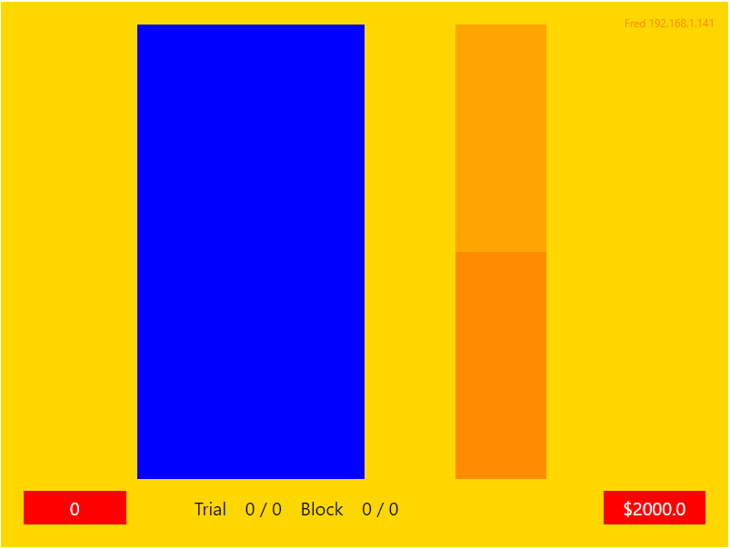
The Dutch Auction Game
Imagine you are the manager of a store and you need to restock your warehouse.

Slide 2
Instructions
You are to use a set allocation of funds to purchase goods to FILL your warehouse (or as close to full as possible).
To do this you will participate in a virtual Dutch Auction.
This is where the price of the items for sale is continually lowered until either a bid is made or time runs out.
In each auction (trial), a fixed amount of stock with varying starting prices will be available for purchase.
The first player to bid wins the items for the current standing price.
To bid press the ‘spacebar’ key.

Slide 3
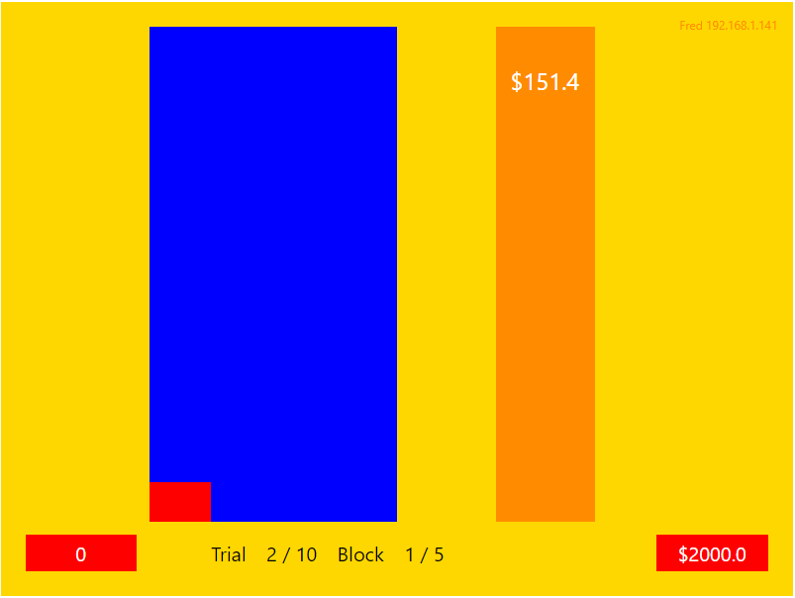
This bar shows the starting price of items for sale.
This will decrease over the time of the trial.

Slide 4
Your funds to bid.
This will decrease with each successful bid.

Slide 5
Numerical display of current stock amount in your warehouse.

Slide 6
Red Bar – shows how the number of items for sale on the current auction will add to your warehouse stock.

Slide 7
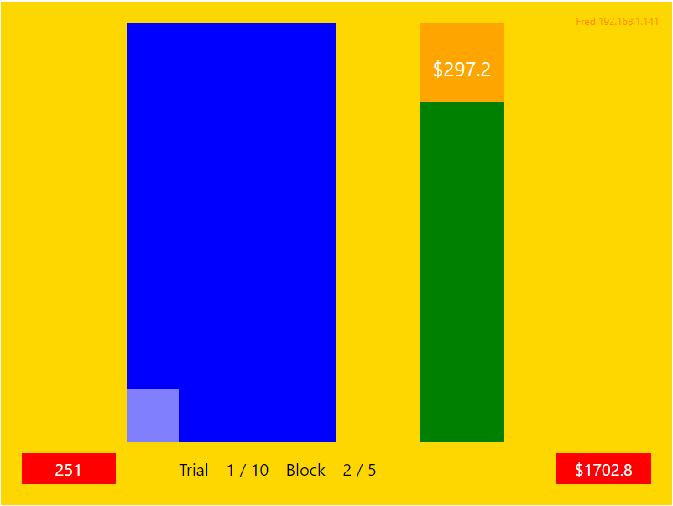
If your bid is successful the price bar will turn green.
And the red bar will turn light blue indicating the stock is now part of your warehouse

Slide 8
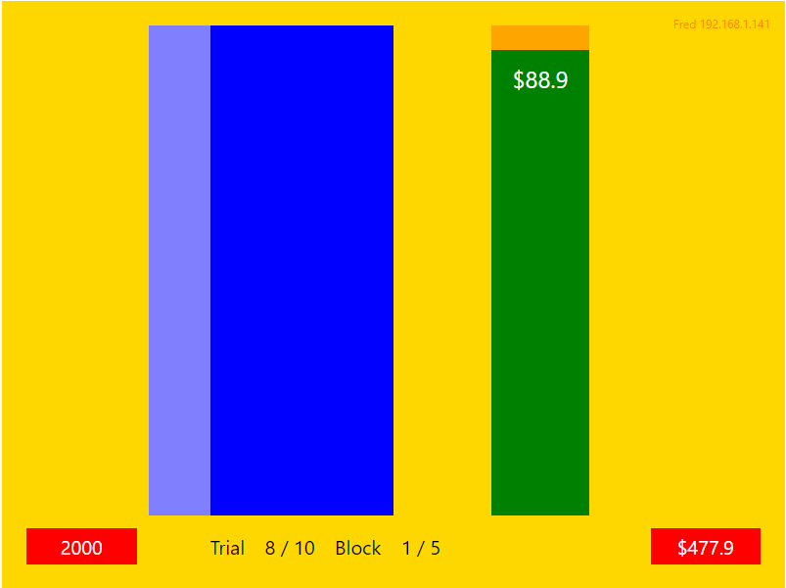
Once the light blue bar reaches the top your warehouse is fully stocked and you can no longer bid.

Slide 9
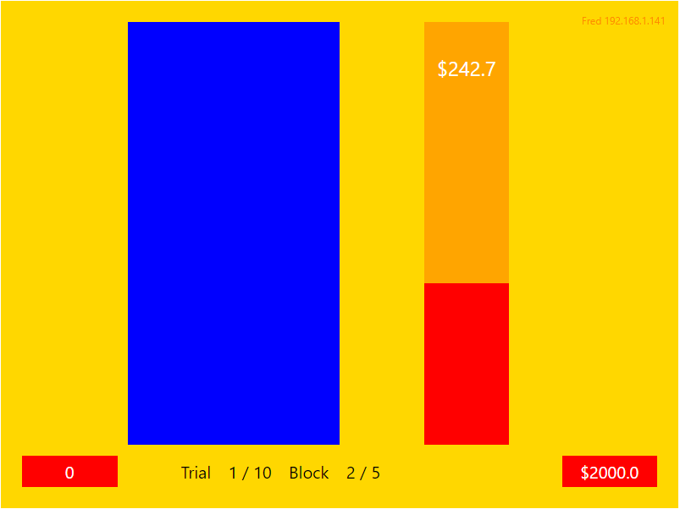
If the price bar turns red an opponent won the auction.
And there will be NO change to your warehouse stock.

Slide 10
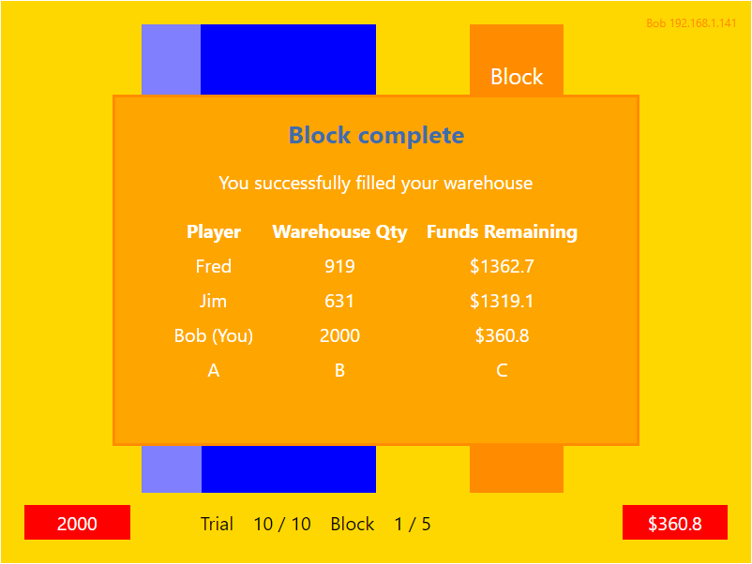
At the end of each block visual feedback will tell you if you filled your warehouse.
The amount of stock you purchased and money you had remaining.

Slide 11
The feedback screen will also show the warehouse stock and remaining funds of your bidding competitors.

Slide 12
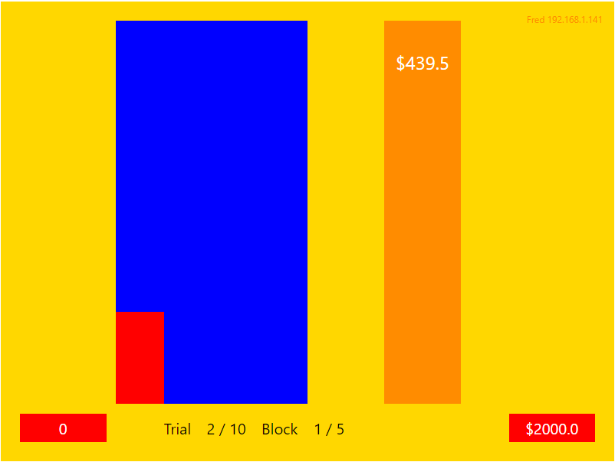
This indicates trial and block number.

Slide 13
Instructions
The session will be divided into FOUR games.
You will first play two games competing against a computer competitor and then two games competing against fellow participants.
Each game will consist of SIX blocks beginning with ONE practice block.
Remember: To bid press the ‘spacebar’ key.

